Slide 1
Asymptotics for the Spatial Extremogram
Richard A. Davis*
Columbia University
Collaborators:
Yongbum Cho, Columbia University
Souvik Ghosh, LinkedIn
Claudia Klüppelberg, Technical University of Munich
Christina Steinkohl, Technical University of Munich

Slide 2
Plan
Warm-up
  Desiderata for spatial extreme models
The Brown-Resnick Model
  Limits of Local Gaussian processes
  Extremogram
  Estimation—pairwise likelihood
  Simulation examples
Estimating the extremogram
  Asymptotics in random location case
Composite likelihood
Simulation examples
Two examples

Slide 3
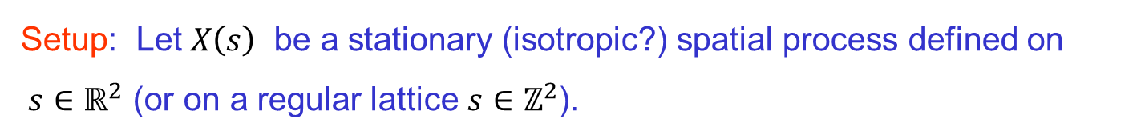
Extremogram in Space
Setup: Let $X\left(s\right)$ be a stationary (isotropic?) spatial process defined on $s∈ℝ^{2}$ (or on a regular lattice $s∈ℤ^{2}$).

Slide 4
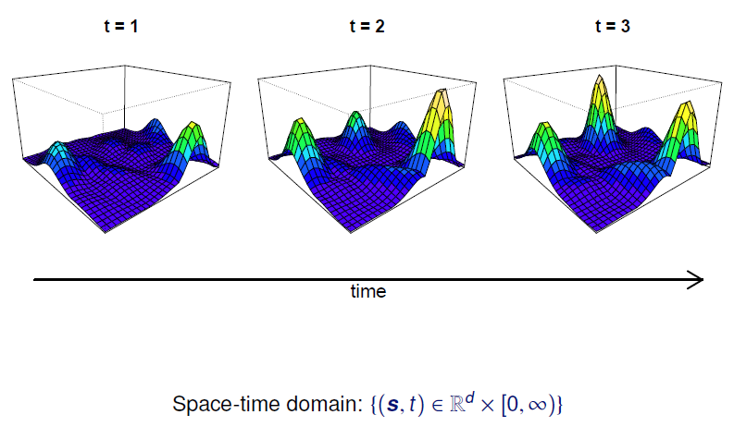
Extremal Dependence in Space and Time
Notes:
The data in Figure 1 are the maximum flow rate (cubic feet per
second) for each week taken from a time series of flow rates recorded at 15 minute intervals for a
river in western Colorado.
(ˆμ, ˆ, ˆ) =
(0.21, 0.91, 0.072)

Slide 5
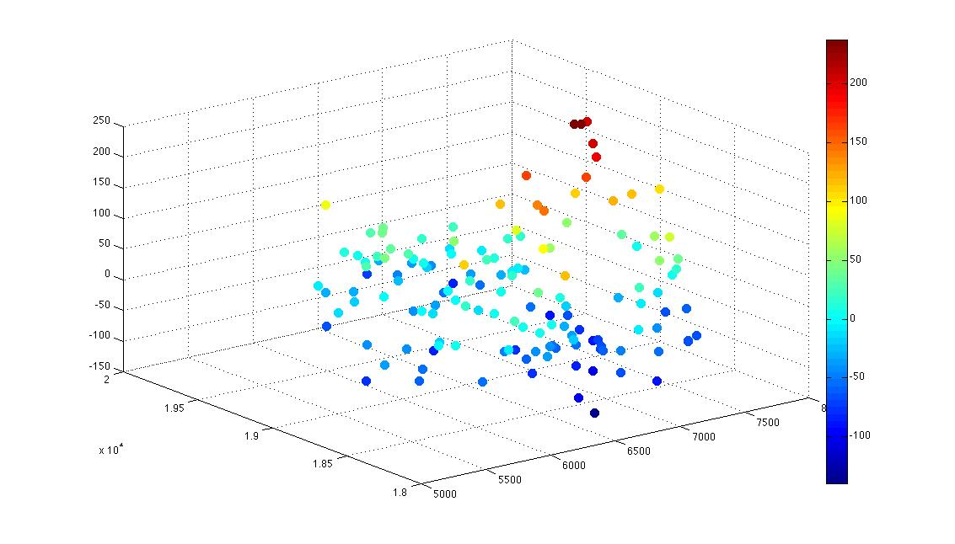
Illustration with French Precipitation Data
Data from Naveau et al. (2009). Precipitation in Bourgogne of France; 51 year maxima of daily precipitation. Data has been adjusted for seasonality and orographic effects.

Slide 6
Warm-up
Desiderata for Spatial Models in Extremes: {Z(s), s ∈ D}
Model is specified on a continuous domain D (not on a lattice).
Process is max-stable: assumption may be physically meaningful, but is it necessary? (i.e., max daily rainfall at various sites.)
Model parameters are interpretable: desirable for any model!
Estimation procedures are available: don’t have to be most efficient.
Finite dimensional distributions (beyond second order) are computable: this allows for computation of various measures of extremal dependence as well as predictive distributions at unobserved locations.
Model is flexible and capable of modeling a wide range of extremal dependencies.

Slide 7
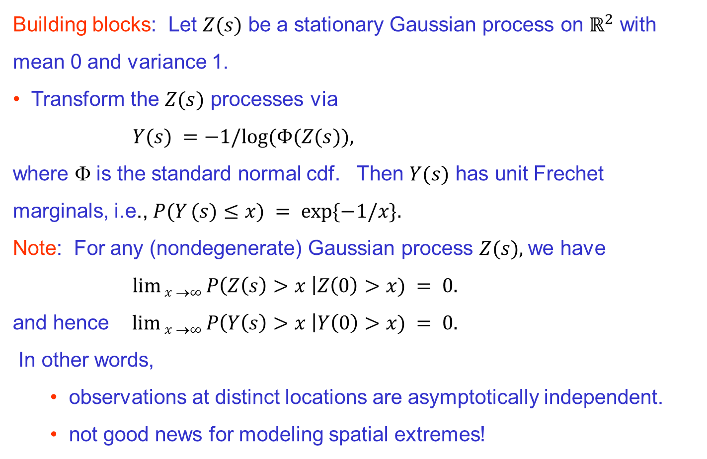
Building a Max-Stable Model in Space
Building blocks: Let $Z(s)$ be a stationary Gaussian process on $ℝ^{2}$ with mean 0 and variance 1.
Transform the $Z(s)$ processes via
$Y(s) =−1/log⁡(Φ(Z(s)),$
where Φ is the standard normal cdf. Then $Y(s)$ has unit Frechet marginals, i.e., $P(Y (s)≤x) = exp⁡\{−1/x\}.$
Note: For any (nondegenerate) Gaussian process $Z(s),$we have
$\lim{x}→∞ P\left(Z\left(s\right)>x \right|Z\left(0\right)>x) = 0.$
and hence $\lim{x}→∞ P\left(Y\left(s\right)>x \right|Y\left(0\right)>x) = 0.$
In other words,
  observations at distinct locations are asymptotically independent.
  not good news for modeling spatial extremes!

Slide 8
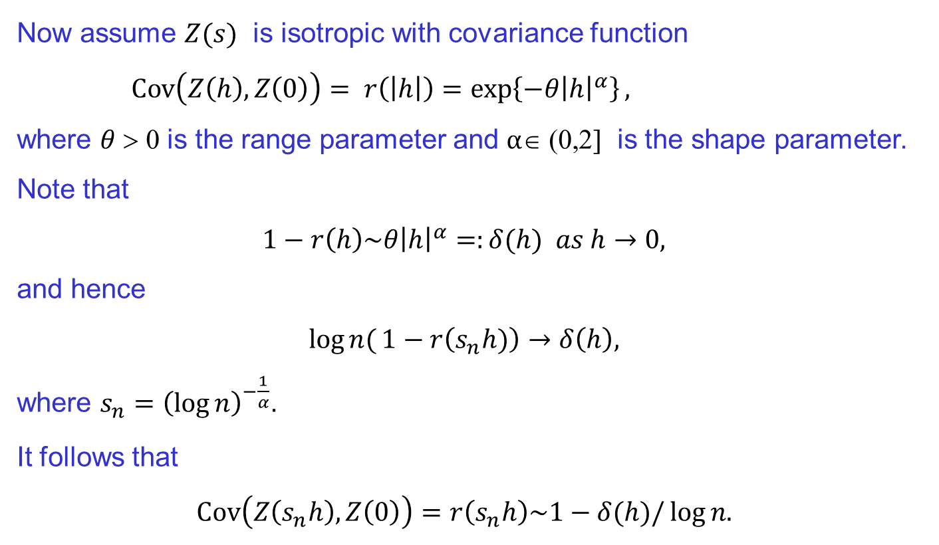
Building a Max-Stable Model in Space-Time
Now assume $Z(s)$ is isotropic with covariance function
$Cov\left(Z\left(h\right),Z\left(0\right)\right)= r\left(\left|h\right|\right)=\exp\left\{−θ{\left|h\right|}^{α}\right\},$
where $θ$ > 0 is the range parameter and $α$∈ (0,2] is the shape parameter. Note that
$$1−r\left(h\right)\sim θ{\left|h\right|}^{α}=:δ(h) as h→0,$$
and hence
$$\log{n(}1−r\left(s_{n}h)\right)→δ\left(h\right),$$
where $s_{n}={\left(\log{n}\right)}^{−\frac{1}{α}}$.
It follows that
$$Cov\left(Z\left(s_{n}h\right),Z\left(0\right)\right)=r\left(s_{n}h\right)\sim 1−δ(h)/\log{n.}$$

Slide 9
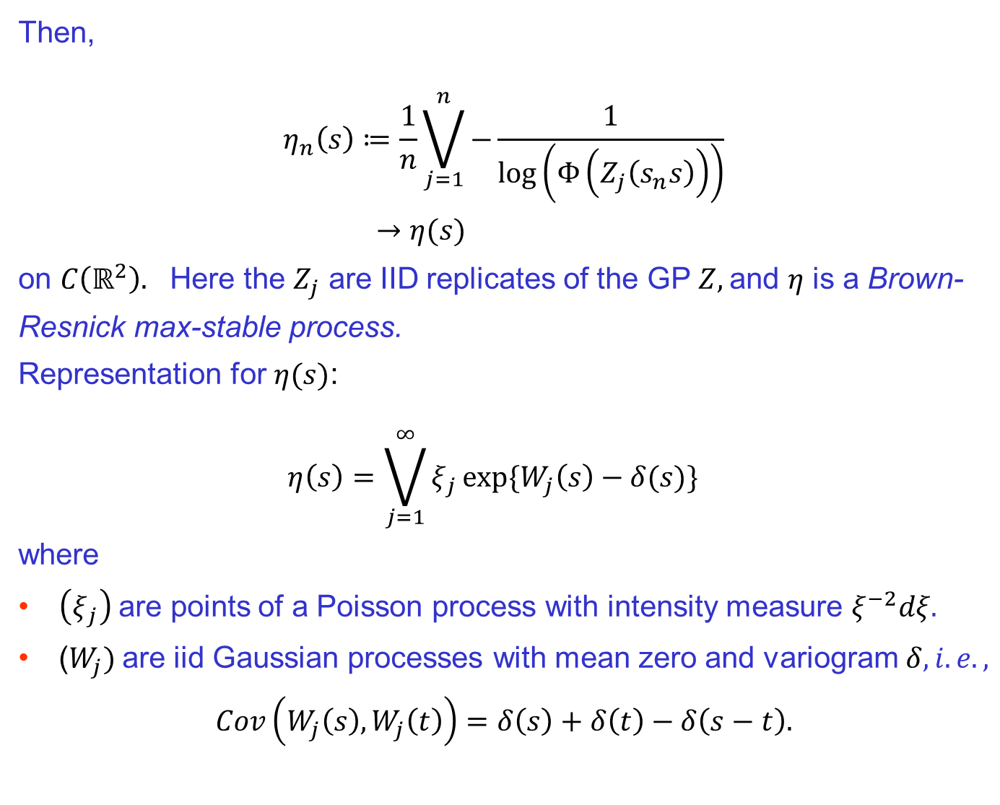
Then,
$$η_{n}\left(s\right)≔\frac{1}{n}\bigvee_{j=1}^{n}{−}\frac{1}{\log\left(Φ\left(Z_{j}\left(s_{n}s\right)\right)\right)}$$
$→η(s)$
on $C\left(ℝ^{2}\right).$ Here the $Z_{j}$ are IID replicates of the GP $Z,$and $η$ is a Brown-Resnick max-stable process.
Representation for $η(s)$:
$$η\left(s\right)=\bigvee_{j=1}^{∞}{ξ_{j}{\exp{{\{W}_{j}\left(s\right)−δ(s)\}}}_{}}$$
where
$\left(ξ_{j}\right) \text{are} \text{points}$ of a Poisson process with intensity measure $ξ^{−2}dξ.$
($W_{j})$are iid Gaussian processes with mean zero and variogram $δ, i.e.,$
$$Cov\left(W_{j}\left(s\right),W_{j}\left(t\right)\right)=δ\left(s\right)+δ\left(t\right)−δ\left(s−t\right).$$
Building a Max-Stable Model in Space-Time

Slide 10
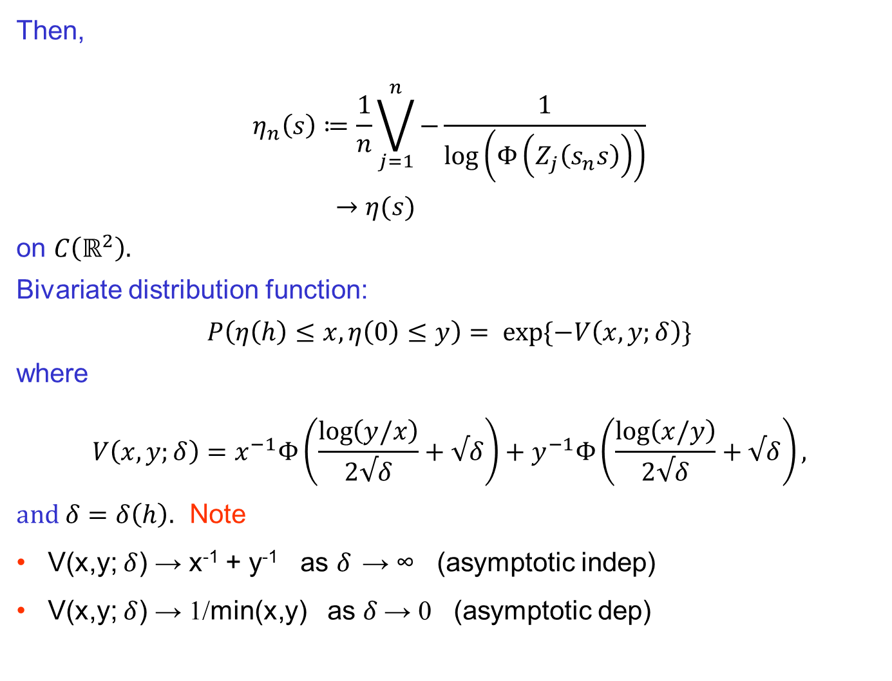
Then,
$$η_{n}\left(s\right)≔\frac{1}{n}\bigvee_{j=1}^{n}{−}\frac{1}{\log\left(Φ\left(Z_{j}\left(s_{n}s\right)\right)\right)}$$
$→η(s)$
on $C\left(ℝ^{2}\right).$
Bivariate distribution function:
$$P\left(η\left(h\right)≤x,η\left(0\right)≤y\right)= exp{\{−V\left(x,y;δ\right)\}}$$
where
$$V\left(x,y;δ\right)=x^{−1}Φ\left(\frac{\log\left(y/x\right)}{2√δ}+√δ\right)+y^{−1}Φ\left(\frac{\log\left(x/y\right)}{2√δ}+√δ\right),$$
and $δ=δ\left(h\right).$ Note
V(x,y; $δ$) → x⁻¹ + y⁻¹ as $δ$ → ∞ (asymptotic indep)
V(x,y; $δ$) → 1/min(x,y) as $δ$→ 0 (asymptotic dep)
Building a Max-Stable Model in Space-Time

Slide 11

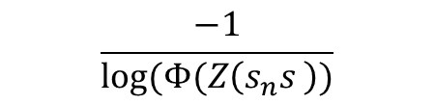
Scaled and transformed Gaussian random fields (fixed time point)
$$\frac{−1}{log⁡(Φ(Z\left(s\right))}$$
$$\frac{−1}{log⁡(Φ(Z\left(s_{n}s \right))}$$
Notes:
The data in Figure 1 are the maximum flow rate (cubic feet per
second) for each week taken from a time series of flow rates recorded at 15 minute intervals for a
river in western Colorado.
(ˆμ, ˆ, ˆ) =
(0.21, 0.91, 0.072)

Slide 12
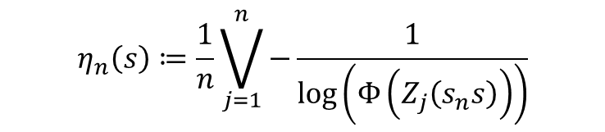
Scaled and transformed Gaussian random fields (fixed time point)
$$η_{n}\left(s\right)≔\frac{1}{n}\bigvee_{j=1}^{n}{−}\frac{1}{\log\left(Φ\left(Z_{j}\left(s_{n}s\right)\right)\right)}$$
Notes:
The data in Figure 1 are the maximum flow rate (cubic feet per
second) for each week taken from a time series of flow rates recorded at 15 minute intervals for a
river in western Colorado.
(ˆμ, ˆ, ˆ) =
(0.21, 0.91, 0.072)

Slide 13
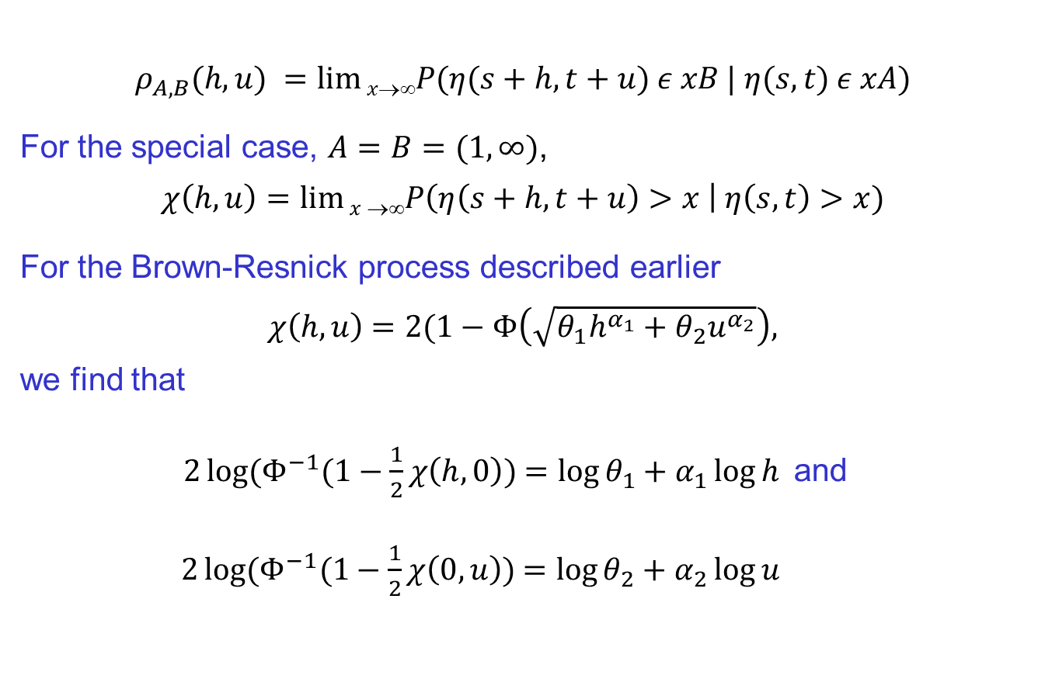
Space-Time Extremogram
$$ρ_{A,B}(h,u) =lim⁡xP(η(s+h,t+u) ε xB | η(s,t) ε xA)$$
For the special case, $A=B=(1,∞)$,
$$χ\left(h,u\right)=\lim{x}→∞P\left(η\left(s+h,t+u\right)>x \right| η\left(s,t\right)>x)$$
For the Brown-Resnick process described earlier
$χ\left(h,u\right)$ $=2(1−Φ\left(\sqrt{θ_{1}h^{α_{1}}+θ_{2}u^{α_{2}}}\right),$
we find that
$2\log{(Φ^{−1}(1−\frac{1}{2}}χ\left(h,0\right)$) $=\log{θ_{1}+α_{1}\log{h}}$and
$2\log{(Φ^{−1}(1−\frac{1}{2}}χ\left(0,u\right)$) $=\log{θ_{2}+α_{2}\log{u}}$
Notes:
The data in Figure 1 are the maximum flow rate (cubic feet per
second) for each week taken from a time series of flow rates recorded at 15 minute intervals for a
river in western Colorado.
(ˆμ, ˆ, ˆ) =
(0.21, 0.91, 0.072)

Slide 14
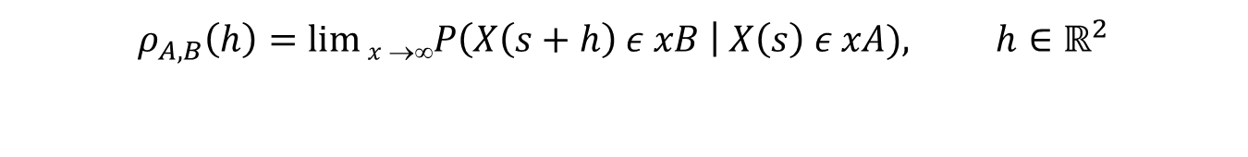
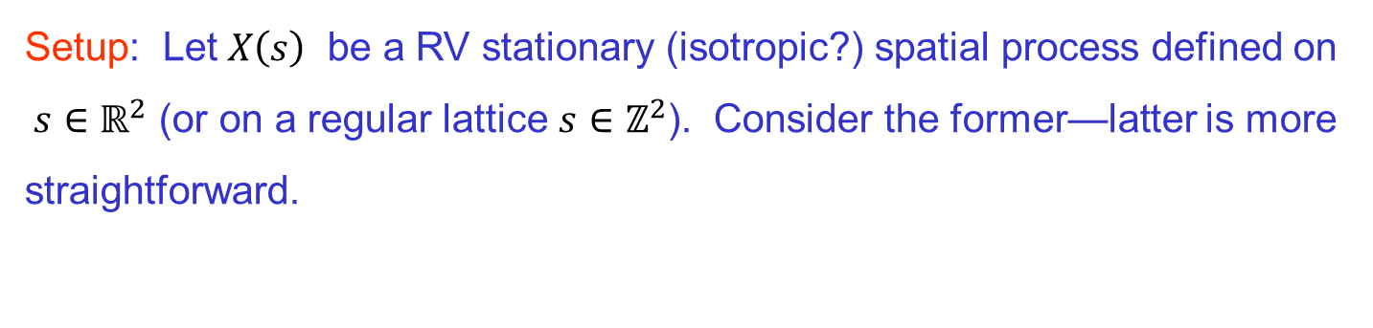
Lattice vs cont space
Setup: Let $X\left(s\right)$ be a RV stationary (isotropic?) spatial process defined on $s∈ℝ^{2}$ (or on a regular lattice $s∈ℤ^{2}$). Consider the former—latter is more straightforward.
$$ρ_{A,B}\left(h\right)=\lim{x}→∞P\left(X\left(s+h\right) ε xB \right| X\left(s\right) ε xA), h∈ℝ^{2}$$
regular grid
random pattern

Slide 15
France Precipitation Data
regular or random?
Regular or random

Slide 16
Regular grid
regular grid
h = 1; # of pairs = 4
h = sqrt(10); # of pairs = 8
h = sqrt(2); # of pairs = 4
h = sqrt(18); # of pairs = 4
h = 2; # of pairs = 4

Slide 17

Random pattern
random pattern
h = 1; # of pairs = 0
h = 1 $±$.25

Slide 18
Random pattern
Zoom-in
buffer
Estimate of extremogram at lag h = 1 for red point: weight “indicators of points” in the buffer.
Bandwidth: half the width of the buffer.

Slide 19
Random pattern
random pattern
Note:
  Expanding domain asymptotics: domain is getting bigger.
  Not infill asymptotics: insert more points in fixed domain.

Slide 20
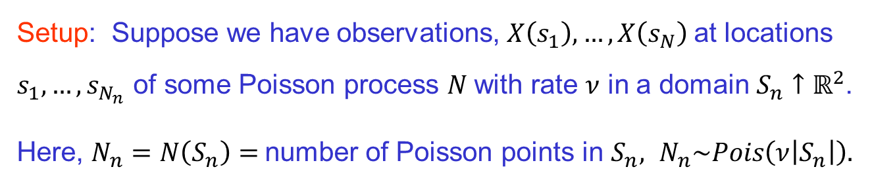

Estimating the extremogram--random pattern
Setup: Suppose we have observations, $X\left(s_{1}\right),…, X\left(s_{N}\right)$at locations $s_{1},…,s_{N_{n}}$ of some Poisson process $N$with rate $ν$ in a domain $S_{n}↑ℝ^{2}$.
Here, $N_{n}=N\left(S_{n}\right)=$number of Poisson points in $S_{n},$ $N_{n}\sim Pois\left(ν\left|S_{n}\right|\right).$
Weight function $w_{n}(x)$: Let $w\left(⋅\right)$be a bounded pdf and set
$$w_{n}\left(x\right)=\frac{1}{λ_{n}^{2}}w\left(\frac{x}{λ_{n}}\right),$$
where the bandwidth $λ_{n}→0 and { λ}_{n}^{2}\left|S_{n}\right|→∞.$

Slide 21
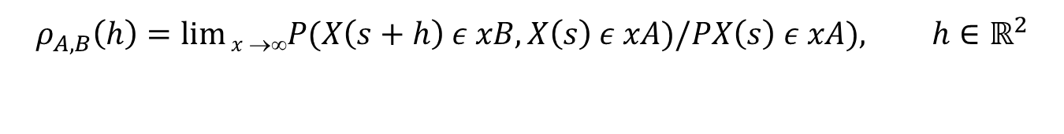
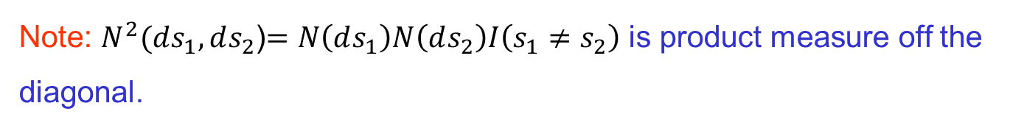
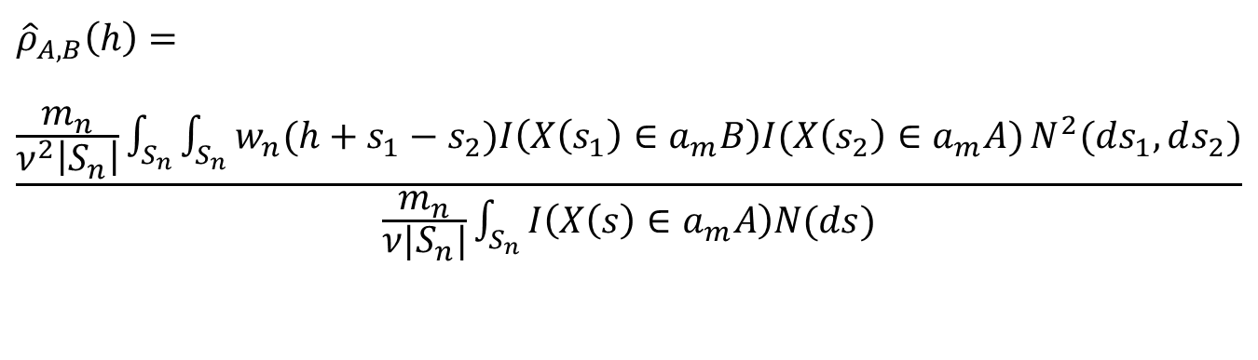
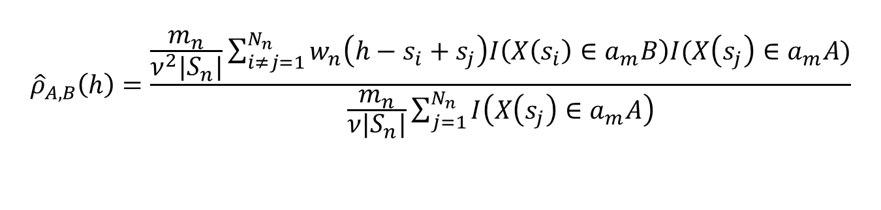
Estimating extremogram--random pattern
$$ρ_{A,B}\left(h\right)=\lim{x}→∞P(X\left(s+h\right) ε xB,X\left(s\right) ε xA)/PX\left(s\right) ε xA), h∈ℝ^{2}$$
Kernel estimate of $ρ$:
$${\hat{ρ}}_{A,B}\left(h\right)=\frac{\frac{m_{n}}{ν^{2}|S_{n}|}\sum_{i≠j=1}^{N_{n}}{w_{n}\left(h−s_{i}+s_{j}\right)I\left(X\left(s_{i}\right)∈a_{m}B\right)I(X\left(s_{j}\right)∈a_{m}A)}}{\frac{m_{n}}{ν|S_{n}|}\sum_{j=1}^{N_{n}}{I\left(X\left(s_{j}\right)∈a_{m}A\right)}}$$
$${\hat{ρ}}_{A,B}\left(h\right)=\frac{\frac{m_{n}}{ν^{2}\left|S_{n}\right|}\int_{S_{n}}{\int_{S_{n}}{w_{n}(h+s_{1}−s_{2})I\left(X\left(s_{1}\right)∈a_{m}B\right)I(X\left(s_{2}\right)∈a_{m}A})}N^{2}(ds_{1},ds_{2})}{\frac{m_{n}}{ν|S_{n}|}\int_{S_{n}}{I\left(X\left(s\right)∈a_{m}A\right)N(ds)}}$$
Note: $N^{2}(ds_{1},ds_{2}$)$=N\left(ds_{1}\right)N\left(ds_{2}\right)I\left(s_{1}≠s_{2}\right)$ is product measure off the diagonal.

Slide 22


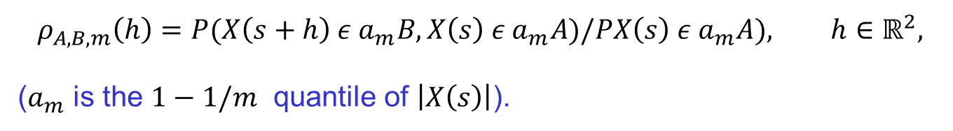
Limit Theory
Theorem: Under suitable conditions on $\left(X\left(s\right)\right),$ (i.e., regularly varying, mixing, local uniform negligibility, etc.), then
where $ρ_{A,B,m}\left(h\right)$ is the pre-asymptotic extremogram,
$${\left(\frac{\left|S_{n}\right|λ_{n}^{2}}{m_{n}}\right)}^{\frac{1}{2}}\left({\hat{ρ}}_{A,B}\left(h\right)−ρ_{A,B,m}\left(h\right)\right)→N\left(0,Σ\right),$$
$$ρ_{A,B,m}\left(h\right)=P(X\left(s+h\right) ε a_{m}B,X\left(s\right) ε a_{m}A)/PX\left(s\right) ε a_{m}A), h∈ℝ^{2},$$
($a_{m}$ is the $1−1/m$ quantile of $\left|X\left(s\right)\right|$).
Remark: The formulation of this estimate and its proof follow the ideas of Karr (1986) and Li, Genton, and Sherman (2008).

Slide 23

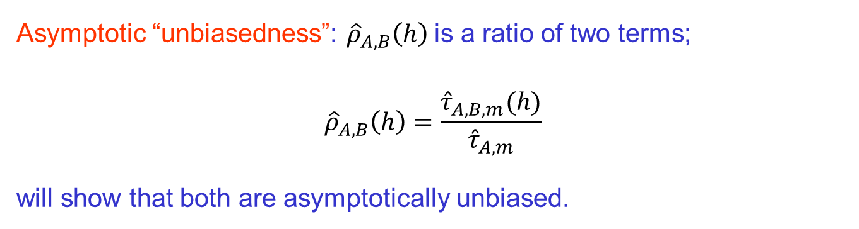
Limit theory
Asymptotic “unbiasedness”: ${\hat{ρ}}_{A,B}\left(h\right)$is a ratio of two terms;
$${\hat{ρ}}_{A,B}\left(h\right)=\frac{{\hat{τ}}_{A,B, m}(h)}{{\hat{τ}}_{A, m}}$$
will show that both are asymptotically unbiased.
Denominator: By RV, stationarity, and independence of $N$ and $\left(X\left(s\right)\right),$
$$E{\hat{τ}}_{A, m}=E\left(\frac{m_{n}}{ν|S_{n}|}\int_{S_{n}}{I\left(X\left(s\right)∈a_{m}A\right)N(ds)}\right)$$
$$=\frac{m_{n}}{ν\left|S_{n}\right|}P\left(X\left(0\right)∈a_{m}A\right)E\left(N\left(S_{n}\right)\right)$$
$$=m_{n}P\left(X\left(0\right)∈a_{m}A\right)$$
$$→μ(A)$$

Slide 24
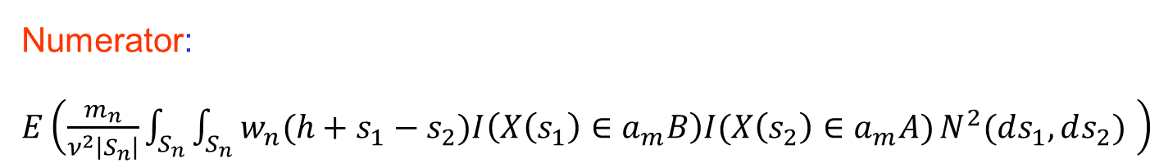
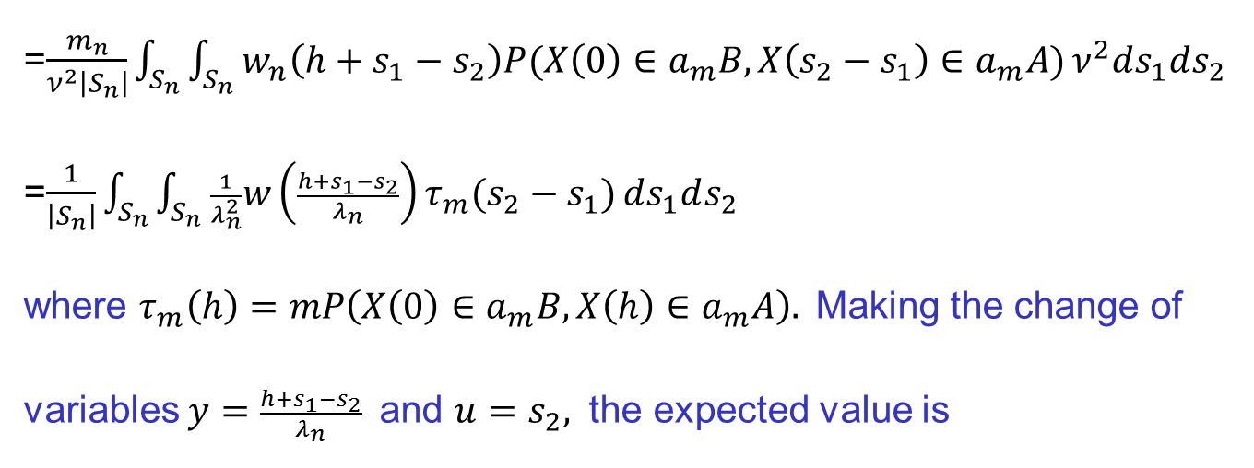
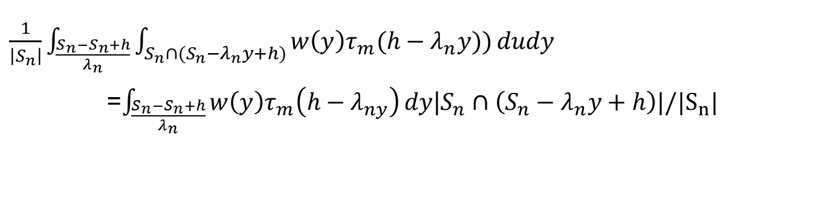
Limit Theory
Numerator:$E\left(\frac{m_{n}}{ν^{2}\left|S_{n}\right|}\int_{S_{n}}{\int_{S_{n}}{w_{n}(h+s_{1}−s_{2})I\left(X\left(s_{1}\right)∈a_{m}B\right)I(X\left(s_{2}\right)∈a_{m}A})}N^{2}(ds_{1},ds_{2}) \right)$
=$\frac{m_{n}}{ν^{2}\left|S_{n}\right|}\int_{S_{n}}{\int_{S_{n}}{w_{n}\left(h+s_{1}−s_{2}\right)P(X\left(0\right)∈a_{m}B,X\left(s_{2}−s_{1}\right)∈a_{m}A})}ν^{2}ds_{1}ds_{2}$
=$\frac{1}{\left|S_{n}\right|}\int_{S_{n}}{\int_{S_{n}}{\frac{1}{λ_{n}^{2}}w\left(\frac{h+s_{1}−s_{2}}{λ_{n}}\right)}τ_{m}(s_{2}−s_{1})}ds_{1}ds_{2}$
where $τ_{m}\left(h\right)=mP\left(X\left(0\right)∈a_{m}B,X\left(h\right)∈a_{m}A\right).$Making the change of variables $y=\frac{h+s_{1}−s_{2}}{λ_{n}}$ and $u=s_{2},$ the expected value is
$\frac{1}{\left|S_{n}\right|}\int_{\frac{S_{n}−S_{n}+h}{λ_{n}}}{\int_{S_{n}∩(S_{n}−λ_{n}y+h)}{w\left(y\right)τ_{m}(h−λ_{n}y)})}dudy$
=$\int_{\frac{S_{n}−S_{n}+h}{λ_{n}}}{w\left(y\right)τ_{m}\left(h−λ_{ny}\right)}dy$|$S_{n}∩\left(S_{n}−λ_{n}y+h\right)|/|S_{n}|$

Slide 25
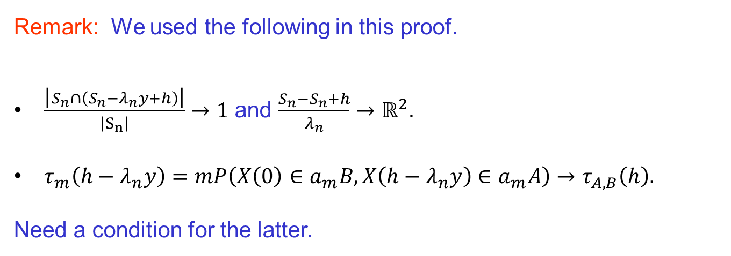
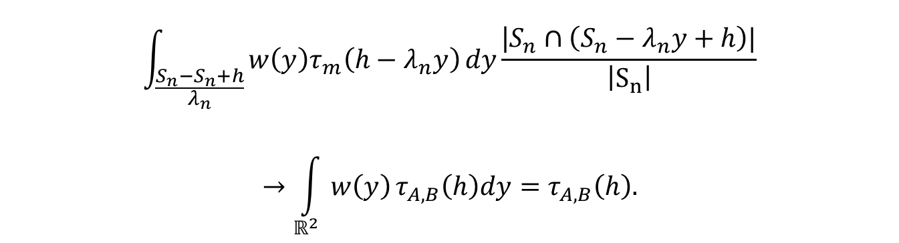
Limit Theory
$$\int_{\frac{S_{n}−S_{n}+h}{λ_{n}}}{w\left(y\right)τ_{m}\left(h−λ_{n}y\right)}dy\frac{\text{|}S_{n}∩\left(S_{n}−λ_{n}y+h\right)|}{\left|S_{n}\right|}$$
$$→\int_{ℝ^{2}}{w\left(y\right)}τ_{A,B}\left(h\right)dy=τ_{A,B}\left(h\right).$$
Remark: We used the following in this proof.
$\frac{\text{|}S_{n}∩\left(S_{n}−λ_{n}y+h\right)\text{|}}{\left|S_{n}\right|}→1$ and $\frac{S_{n}−S_{n}+h}{λ_{n}}$ $→ℝ^{2}$.
$τ_{m}\left(h−λ_{n}y\right)=mP\left(X\left(0\right)∈a_{m}B,X\left(h−λ_{n}y\right)∈a_{m}A\right)→τ_{A,B}\left(h\right).$
Need a condition for the latter.

Slide 26
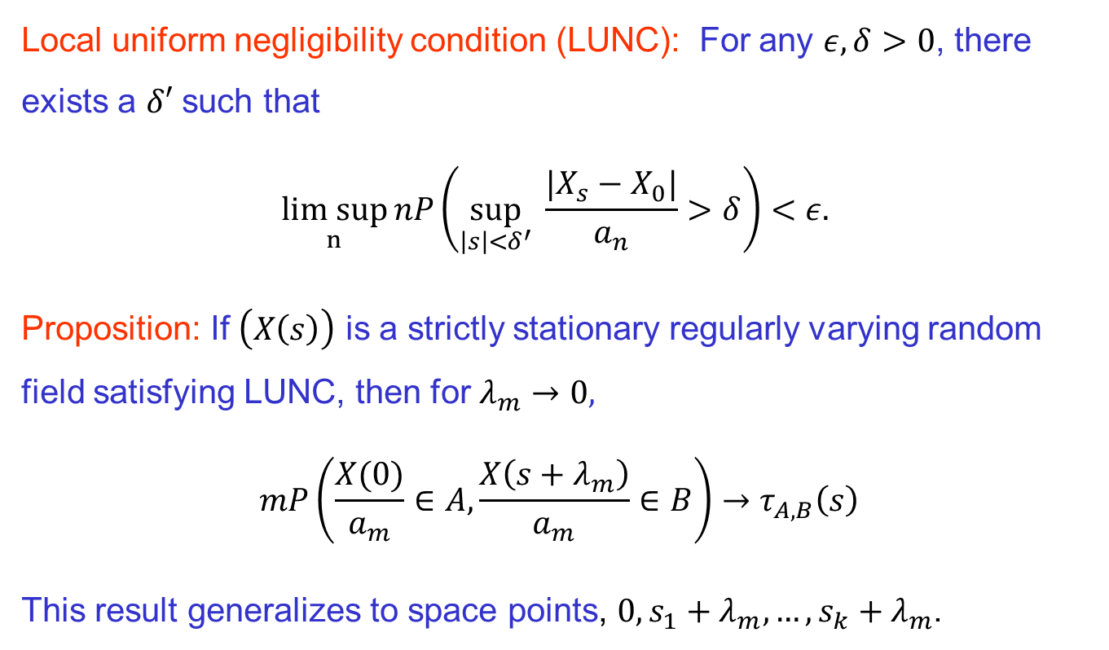
Limit theory
Local uniform negligibility condition (LUNC): For any $ε,δ>0$, there exists a $δ′$ such that
$$\underset{n}{lim sup}{nP\left(\sup_{\left|s\right|<δ^{′}}{ \frac{|X_{s}−X_{0}|}{a_{n}}}>δ\right)<ε. }$$
Proposition: If $\left(X\left(s\right)\right)$ is a strictly stationary regularly varying random field satisfying LUNC, then for $λ_{m}→0,$
$$mP\left(\frac{X(0)}{a_{m}}∈A,\frac{X\left(s+λ_{m}\right)}{a_{m}}∈B\right)→τ_{A,B}\left(s\right)$$
This result generalizes to space points, $0,s_{1}+λ_{m}, …,s_{k}+λ_{m}$.

Slide 27
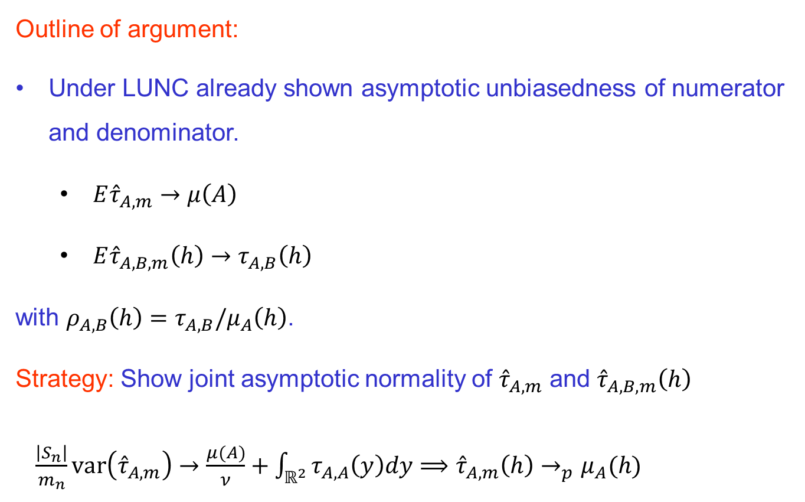
Limit Theory
Outline of argument:
Under LUNC already shown asymptotic unbiasedness of numerator and denominator.
  $E{\hat{τ}}_{A, m}→μ\left(A\right)$
  $E{\hat{τ}}_{A, B,m}\left(h\right)→τ_{A,B}\left(h\right)$
with $ρ_{A,B}\left(h\right)=τ_{A,B}/μ_{A}\left(h\right)$.
Strategy: Show joint asymptotic normality of ${\hat{τ}}_{A, m}$ and ${\hat{τ}}_{A, B,m}\left(h\right)$
$\frac{\left|S_{n}\right|}{m_{n}}var\left({\hat{τ}}_{A, m}\right)→\frac{μ(A)}{ν}+\int_{ℝ^{2}}{τ_{A,A}\left(y\right)dy⟹{\hat{τ}}_{A, m}\left(h\right)→_{p}μ_{A}(h)}$

Slide 28
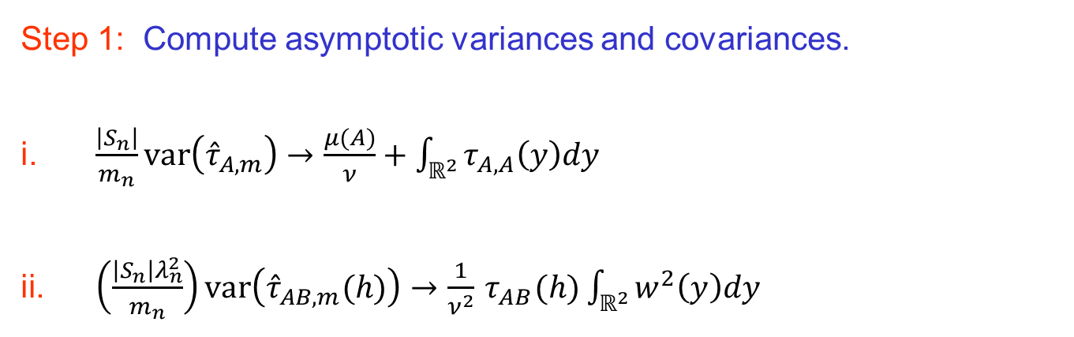

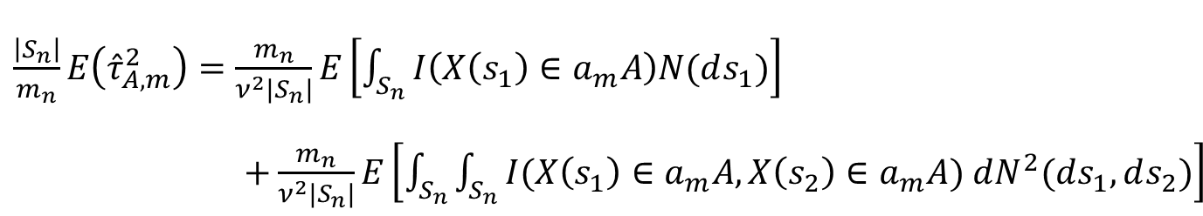
Limit Theory
Step 1: Compute asymptotic variances and covariances.
$\frac{\left|S_{n}\right|}{m_{n}}var\left({\hat{τ}}_{A, m}\right)→\frac{μ(A)}{ν}+\int_{ℝ^{2}}{τ_{A,A}\left(y\right)dy}$
$\left(\frac{\left|S_{n}\right|λ_{n}^{2}}{m_{n}}\right)var\left({\hat{τ}}_{AB, m}(h)\right)→\frac{1}{ν^{2}}{ τ}_{AB}(h)\int_{ℝ^{2}}{w^{2}\left(y\right)dy}$
Proof of (i): Sum of variances + sum of covariances
$\frac{\left|S_{n}\right|}{m_{n}}E\left({\hat{τ}}_{A, m}^{2}\right)=\frac{m_{n}}{ν^{2}{|S}_{n}|}E\left[\int_{S_{n}}{I\left(X\left(s_{1}\right)∈a_{m}A\right)N(ds_{1})}\right]$ $+\frac{m_{n}}{ν^{2}{|S}_{n}|}E\left[\int_{S_{n}}{\int_{S_{n}}{I(X\left(s_{1}\right)∈a_{m}A,X\left(s_{2}\right)∈a_{m}A}}) dN^{2}(ds_{1},ds_{2})\right]$
$$→\frac{μ(A)}{ν}+\int_{ℝ^{2}}{τ_{A,A}\left(y\right)dy}$$

Slide 29
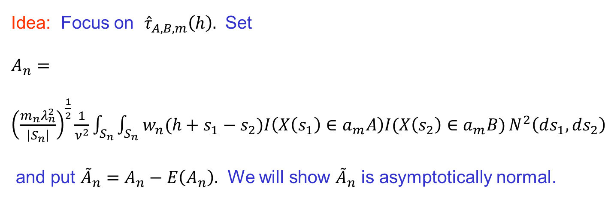
Limit Theory
Step 2: Show joint CLT for ${\hat{τ}}_{A, m}$ and ${\hat{τ}}_{A, B,m}\left(h\right)$ using a blocking argument.
Idea: Focus on ${\hat{τ}}_{A, B,m}\left(h\right).$ Set
$A_{n}={\left(\frac{m_{n}λ_{n}^{2}}{\left|S_{n}\right|}\right)}^{\frac{1}{2}}\frac{1}{ν^{2}}\int_{S_{n}}{\int_{S_{n}}{w_{n}(h+s_{1}−s_{2})I\left(X\left(s_{1}\right)∈a_{m}A\right)I(X\left(s_{2}\right)∈a_{m}B})}N^{2}\left(ds_{1},ds_{2}\right)$
and put ${\tilde{A}}_{n}=A_{n}−E\left(A_{n}\right).$ We will show ${\tilde{A}}_{n}$ is asymptotically normal.

Slide 30

Limit Theory
Subdivide $S_{n}={\left[0,n\right]}^{2}$ into big blocks and small blocks.
$S_{n}=∪_{i=1}^{k_{n}}D_{i}$ where $D_{i} has diminesions n^{α}×n^{α}$and size $\left|D_{i}\right|=n^{2α}$
$$D_{i}$$

Slide 31

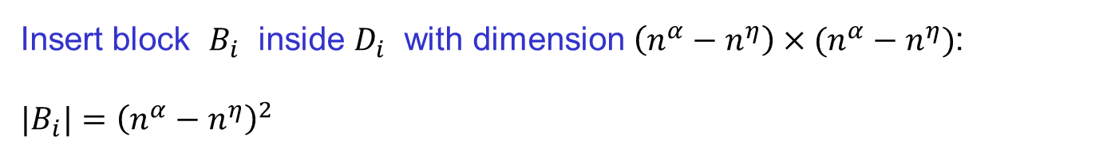
Limit Theory
Insert block $B_{i}$ inside $D_{i}$ with dimension $\left(n^{α}−n^{η}\right)×(n^{α}−n^{η})$:
${|B}_{i}|={\left(n^{α}−n^{η}\right)}^{2}$
Subdivide $S_{n}={\left[0,n\right]}^{2}$ into big blocks and small blocks.
$S_{n}=∪_{i=1}^{k_{n}}D_{i}$ where $D_{i} has diminesions n^{α}×n^{α}$and size $\left|D_{i}\right|=n^{2α}$
$$B$$
$$D_{i}$$

Slide 32
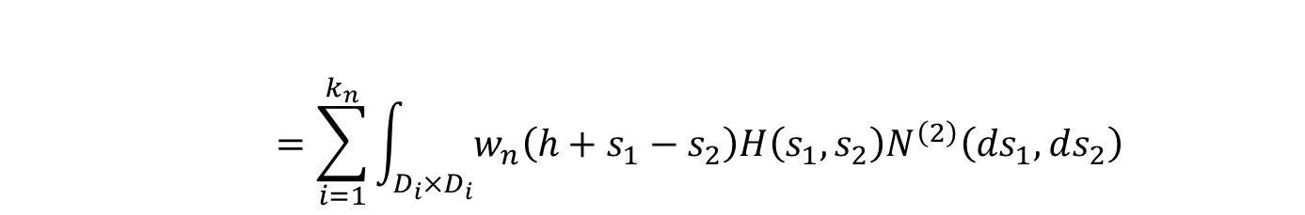

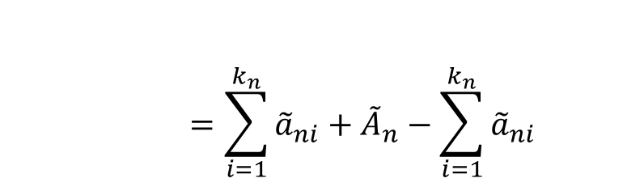



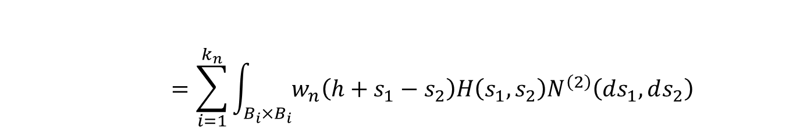
Limit Theory
Recall that ${\tilde{A}}_{n}$ is a (mean-corrected) double integral over $S_{n}×S_{n}, i.e.,$
$${\tilde{A}}_{n}=\int_{S_{n}×S_{n}}{w_{n}\left(h+s_{1}−s_{2}\right)H\left(s_{1},s_{2}\right)N^{\left(2\right)}\left(ds_{1},ds_{2}\right)}$$
$$=\sum_{i=1}^{k_{n}}{\int_{D_{i}×D_{i}}{w_{n}\left(h+s_{1}−s_{2}\right)H\left(s_{1},s_{2}\right)N^{\left(2\right)}\left(ds_{1},ds_{2}\right)}}$$
$$=\sum_{i=1}^{k_{n}}{\int_{B_{i}×B_{i}}{w_{n}\left(h+s_{1}−s_{2}\right)H\left(s_{1},s_{2}\right)N^{\left(2\right)}\left(ds_{1},ds_{2}\right)}}$$
$$D_{i}$$
$$B_{i}$$
$+$ $R_{n}$
$$=\sum_{i=1}^{k_{n}}{{\tilde{a}}_{ni}}+{\tilde{A}}_{n}−\sum_{i=1}^{k_{n}}{{\tilde{a}}_{ni}}$$

Slide 33
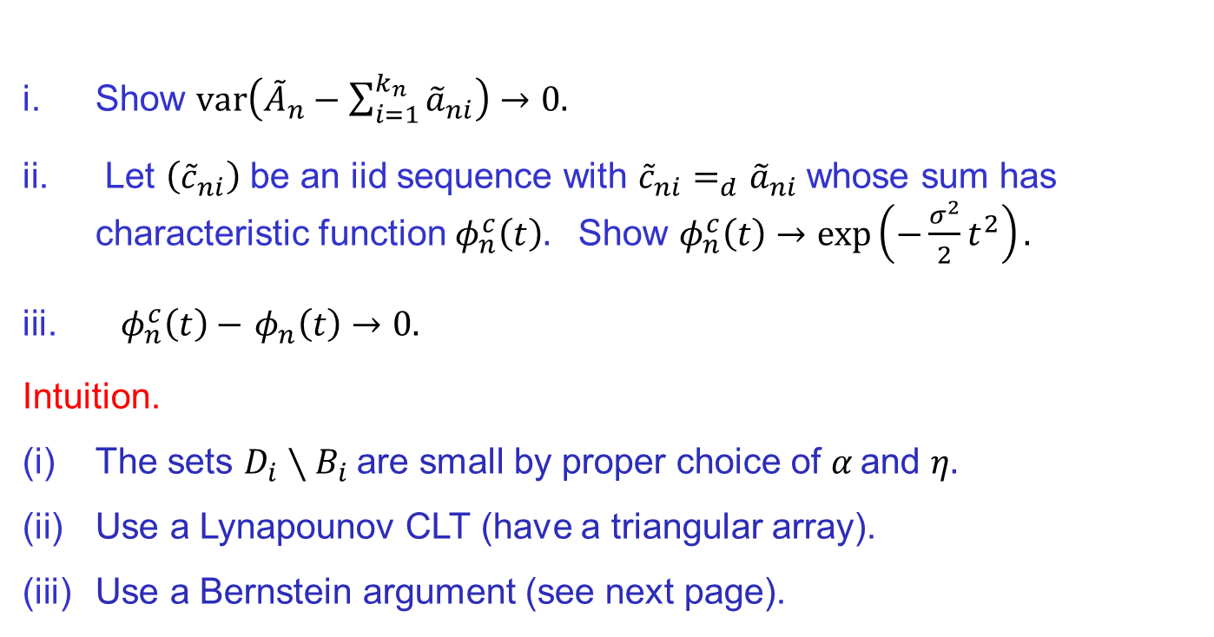

Limit Theory
$${\tilde{a}}_{ni}=\int_{B_{i}×B_{i}}{w_{n}\left(h+s_{1}−s_{2}\right)H\left(s_{1},s_{2}\right)N^{\left(2\right)}\left(ds_{1},ds_{2}\right)}$$
Remaining steps:
Show $var\left({\tilde{A}}_{n}−\sum_{i=1}^{k_{n}}{{\tilde{a}}_{ni}}\right)→0.$
Let $\left({\tilde{c}}_{ni}\right)$ be an iid sequence with ${\tilde{c}}_{ni}=_{d}{\tilde{a}}_{ni}$whose sum has characteristic function $φ_{n}^{c}\left(t\right).$ Show $φ_{n}^{c}\left(t\right)→\exp\left(−\frac{σ^{2}}{2}t^{2}\right).$
${ φ}_{n}^{c}\left(t\right)−$ $φ_{n}\left(t\right)→0.$
Intuition.
The sets $D_{i}∖B_{i}$are small by proper choice of $α \text{and} η.$
Use a Lynapounov CLT (have a triangular array).
Use a Bernstein argument (see next page).

Slide 34
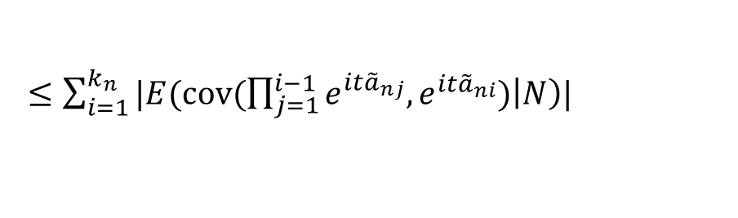

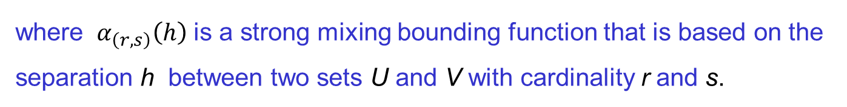
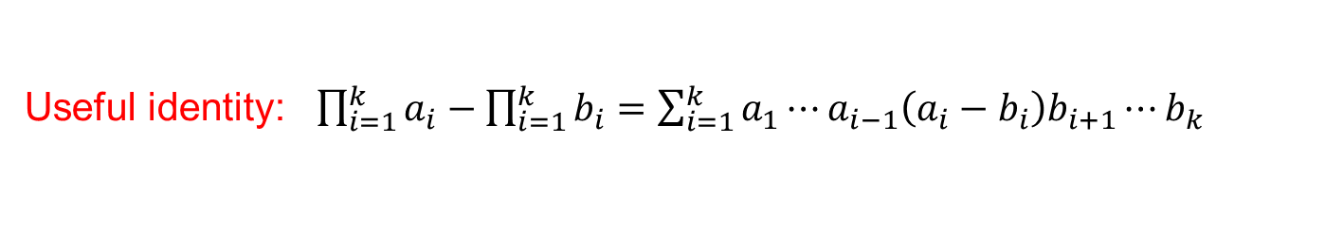
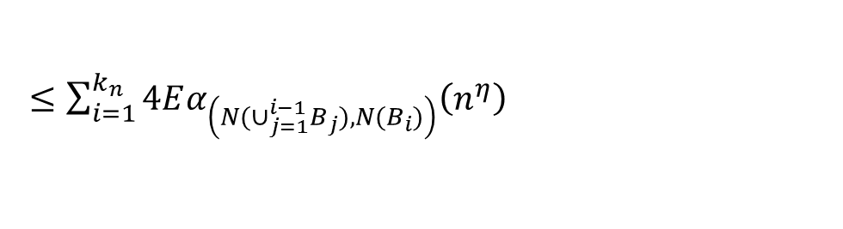
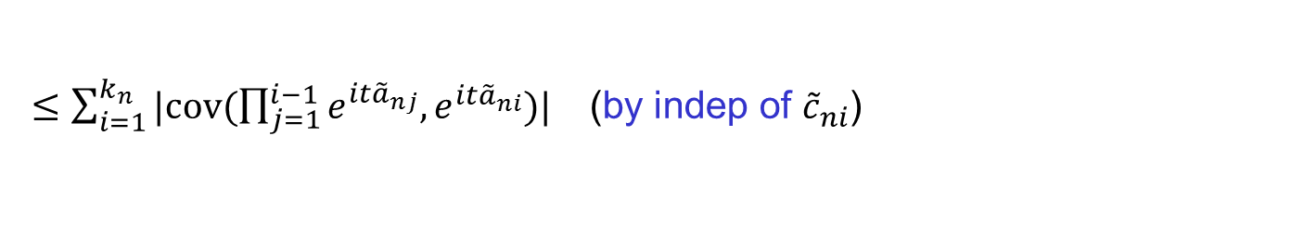

Limit Theory
Useful identity: $\prod_{i=1}^{k}{a_{i}−\prod_{i=1}^{k}{b_{i}=\sum_{i=1}^{k}{a_{1}⋯a_{i−1}\left(a_{i}−b_{i}\right)b_{i+1}⋯b_{k}}}}$
$${|φ}_{n}\left(t\right)−φ_{n}^{c}(t)|=|E\prod_{i=1}{{e^{it{\tilde{a}}_{ni}}}_{}−E\prod_{i=1}^{k}{e^{it{\tilde{c}}_{ni}} |}}$$
$$=|E\sum_{i=1}^{k_{n}}{\prod_{j=1}^{i−1}{e^{it{\tilde{a}}_{nj}}(e^{it{\tilde{a}}_{ni}}−e^{it{\tilde{c}}_{ni}})\prod_{j=i+1}^{k_{n}}{e^{it{\tilde{c}}_{ni}}|}}}$$
$≤\sum_{i=1}^{k_{n}}{|cov(\prod_{j=1}^{i−1}{e^{it{\tilde{a}}_{nj}},e^{it{\tilde{a}}_{ni}})| }}$ (by indep of ${\tilde{c}}_{ni}$)
$≤\sum_{i=1}^{k_{n}}{|E(cov(\prod_{j=1}^{i−1}{e^{it{\tilde{a}}_{nj}},e^{it{\tilde{a}}_{ni}})\left|N\right)|}}$
$≤\sum_{i=1}^{k_{n}}{4Eα_{\left({N(∪}_{j=1}^{i−1}B_{j}),{N(B}_{i})\right)}\left(n^{η}\right)}$
where $α_{\left(r,s\right)}\left(h\right)$ is a strong mixing bounding function that is based on the separation h between two sets U and V with cardinality r and s.

Slide 35
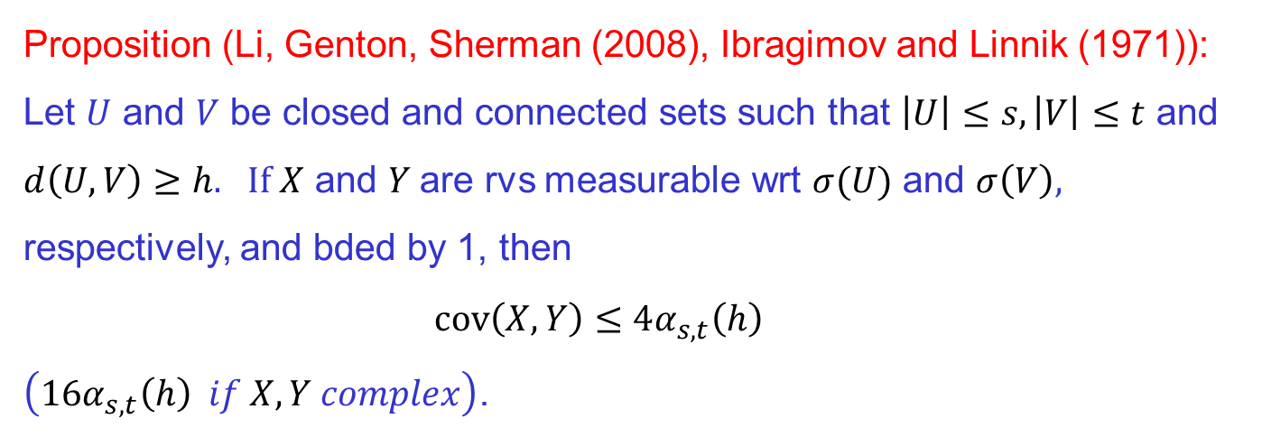
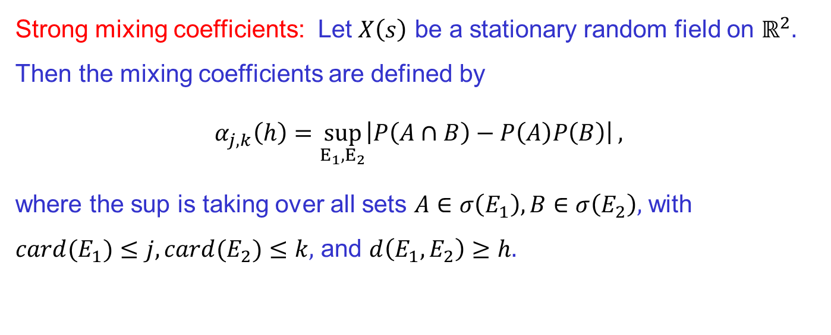
Strong mixing coefficients
Strong mixing coefficients: Let $X\left(s\right)$ be a stationary random field on $ℝ^{2}.$ Then the mixing coefficients are defined by
$$α_{j,k}\left(h\right)=\sup_{E_{1},E_{2}}\left|P\left(A∩B\right)−P\left(A\right)P\left(B\right)\right|,$$
where the sup is taking over all sets $A∈σ\left(E_{1}\right), B∈σ\left(E_{2}\right),$ with ${card(E}_{1})≤j, {card(E}_{2})≤k,$ and $d\left(E_{1},E_{2}\right)≥h.$
Proposition (Li, Genton, Sherman (2008), Ibragimov and Linnik (1971)): Let $U$ and $V$ be closed and connected sets such that $\left|U\right|≤s, \left|V\right|≤t$ and $d\left(U,V\right)≥h.$ $If X$ and $Y$are rvs measurable wrt $σ(U)$ and $σ\left(V\right),$ respectively, and bded by 1, then
$$cov\left(X,Y\right)≤4α_{s,t}\left(h\right)$$
$\left(16α_{s,t}\left(h\right) if X, Y complex\right)$.

Slide 36

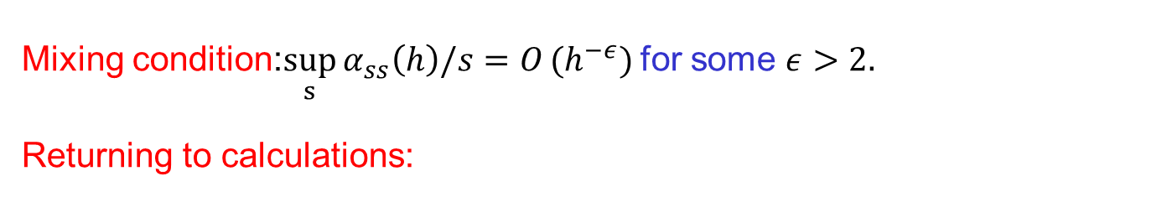
Limit Theory
Mixing condition:$\sup_{s}{α_{ss}\left(h\right)/s=O}(h^{−ε})$ for some $ε>2.$
Returning to calculations:
$${|φ}_{n}\left(t\right)−φ_{n}^{c}(t)|=\sum_{i=1}^{k_{n}}{|cov(\prod_{j=1}^{i−1}{e^{it{\tilde{a}}_{nj}},e^{it{\tilde{a}}_{ni}})| }}$$
$$≤\sum_{i=1}^{k_{n}}{16Eα_{\left({N(∪}_{j=1}^{i−1}B_{j}),{N(B}_{i})\right)}\left(n^{η}\right)} \\ ≤\sum_{i=1}^{k_{n}}{16E}N\left(∪_{j=1}^{i}B_{j}\right)n^{−εη} \\ ≤\sum_{i=1}^{k_{n}}{16in^{2α}n^{−εη}≤Ck_{n}^{2}n^{2α}n^{−εη}} \\ =Cn^{4−2α−εη} \\ →0 if \left(4−2α−εη<0\right).$$

Slide 37
Simulations of spatial extremogram
Extremogram for one realization of B-R process
(function of level)
Note: black dots = true; blue bands are permutation bounds
Lattice
Non-Lattice
Notes:
The data in Figure 1 are the maximum flow rate (cubic feet per
second) for each week taken from a time series of flow rates recorded at 15 minute intervals for a
river in western Colorado.
(ˆμ, ˆ, ˆ) =
(0.21, 0.91, 0.072)

Slide 38
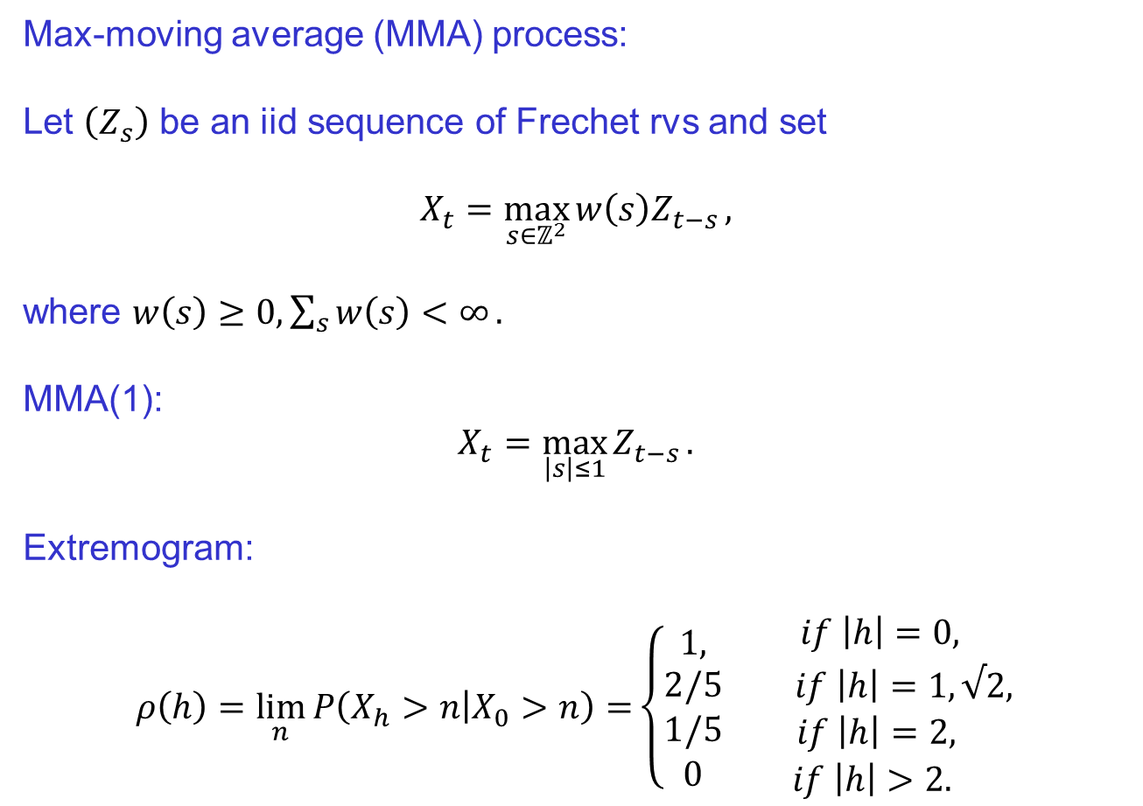
Simulations of spatial extremogram
Max-moving average (MMA) process:
Let $\left(Z_{s}\right)$ be an iid sequence of Frechet rvs and set
$$X_{t}=\max_{s∈ℤ^{2}}{w\left(s\right)Z_{t−s}},$$
where $w\left(s\right)≥0, \sum_{s}{w\left(s\right)<∞}.$
MMA(1):
$$X_{t}=\max_{\left|s\right|≤1}{Z_{t−s}}.$$
Extremogram:
$$ρ\left(h\right)=\lim_{n}{P\left(X_{h}>n | X_{0}>n\right)=}\left\{\begin{matrix}1, \\ \begin{matrix}2/5 \\ \begin{matrix}1/5 \\ 0\end{matrix}\end{matrix}\end{matrix}\right.\begin{matrix} if \left|h\right|=0, \\ \begin{matrix}if \left|h\right|=1,√2, \\ \begin{matrix}if \left|h\right|=2, \\ if \left|h\right|>2. \end{matrix}\end{matrix}\end{matrix}$$
Notes:
The data in Figure 1 are the maximum flow rate (cubic feet per
second) for each week taken from a time series of flow rates recorded at 15 minute intervals for a
river in western Colorado.
(ˆμ, ˆ, ˆ) =
(0.21, 0.91, 0.072)

Slide 39
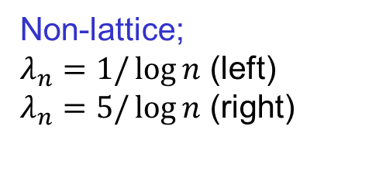
Simulations of spatial extremogram
Box-plots based on 1000 (100) replications of MMA(1) (left) and BR (right)
Lattice
Non-lattice;
$λ_{n}=1/\log{n}$ (left)
$λ_{n}=5/\log{n}$ (right)
Notes:
The data in Figure 1 are the maximum flow rate (cubic feet per
second) for each week taken from a time series of flow rates recorded at 15 minute intervals for a
river in western Colorado.
(ˆμ, ˆ, ˆ) =
(0.21, 0.91, 0.072)

Slide 40
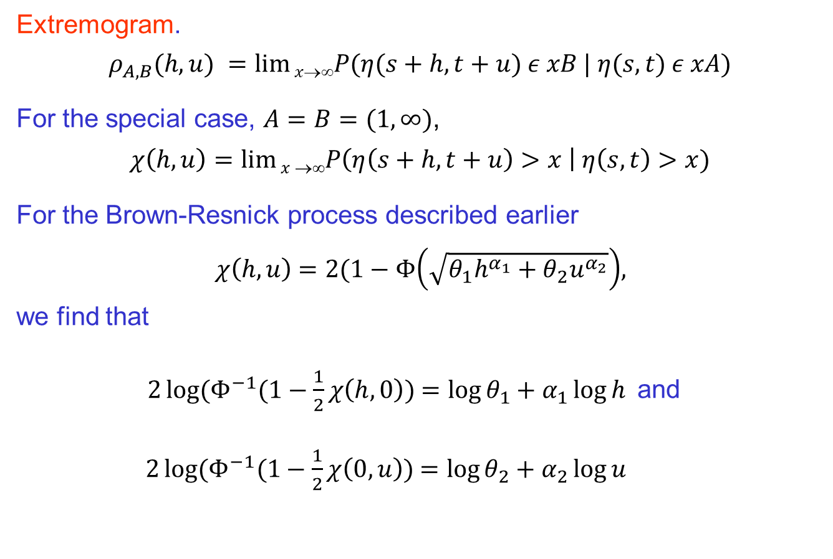
Space-Time Extremogram
Extremogram.
$$ρ_{A,B}(h,u) =lim⁡xP(η(s+h,t+u) ε xB | η(s,t) ε xA)$$
For the special case, $A=B=(1,∞)$,
$$χ\left(h,u\right)=\lim{x}→∞P\left(η\left(s+h,t+u\right)>x \right| η\left(s,t\right)>x)$$
For the Brown-Resnick process described earlier
$χ\left(h,u\right)$ $=2(1−Φ\left(\sqrt{θ_{1}h^{α_{1}}+θ_{2}u^{α_{2}}}\right),$
we find that
$2\log{(Φ^{−1}(1−\frac{1}{2}}χ\left(h,0\right)$) $=\log{θ_{1}+α_{1}\log{h}}$and
$2\log{(Φ^{−1}(1−\frac{1}{2}}χ\left(0,u\right)$) $=\log{θ_{2}+α_{2}\log{u}}$
Notes:
The data in Figure 1 are the maximum flow rate (cubic feet per
second) for each week taken from a time series of flow rates recorded at 15 minute intervals for a
river in western Colorado.
(ˆμ, ˆ, ˆ) =
(0.21, 0.91, 0.072)

Slide 41
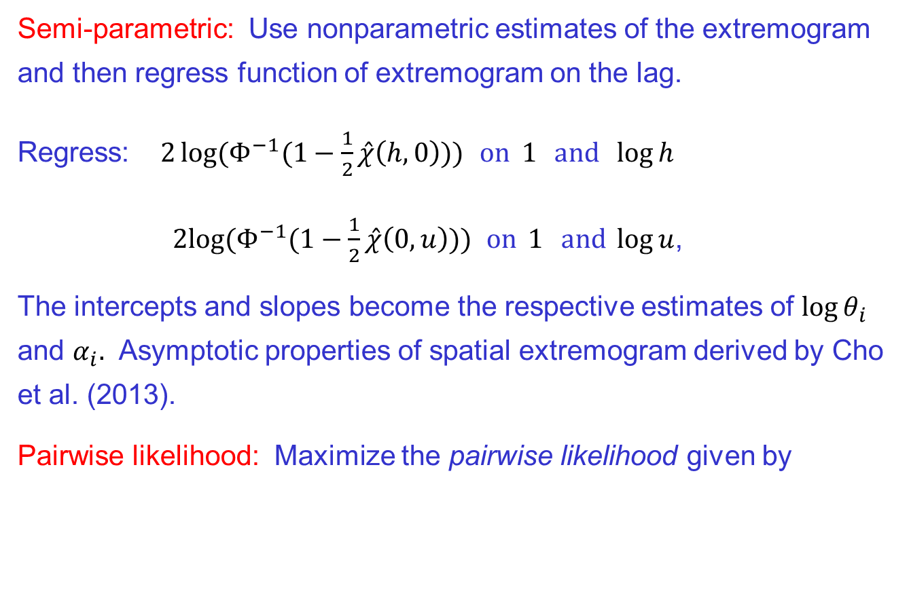
Inference for Brown-Resnick Process
Semi-parametric: Use nonparametric estimates of the extremogram and then regress function of extremogram on the lag.
Regress:$2\log{(Φ^{−1}(1−\frac{1}{2}}\hat{χ}\left(h,0\right)))$ $on 1{ and \log{h}}$
$2log{(Φ^{−1}(1−\frac{1}{2}}\hat{χ}\left(0,u\right)))$ $on 1{ and \log{u}}$,
The intercepts and slopes become the respective estimates of $\log{θ_{i}}$ and $α_{i}.$ Asymptotic properties of spatial extremogram derived by Cho et al. (2013).
Pairwise likelihood: Maximize the pairwise likelihood given by
Notes:
The data in Figure 1 are the maximum flow rate (cubic feet per
second) for each week taken from a time series of flow rates recorded at 15 minute intervals for a
river in western Colorado.
(ˆμ, ˆ, ˆ) =
(0.21, 0.91, 0.072)

Slide 42

Inference for Brown-Resnick Process
Semi-parametric: Use nonparametric estimates of the extremogram and then regress function of extremogram on the lag.
Regress:$2\log{(Φ^{−1}(1−\frac{1}{2}}\hat{χ}\left(h,0\right)$) $on 1{ and \log{h}}$
$2log{(Φ^{−1}(1−\frac{1}{2}}\hat{χ}\left(0,u\right)$) $on 1{ and \log{u}}$,
The intercepts and slopes become the respective estimates of $\log{θ_{i}}$ and $α_{i}.$ Asymptotic properties of spatial extremogram derived by Cho et al. (2013).
Pairwise likelihood: Maximize the pairwise likelihood given by
Notes:
The data in Figure 1 are the maximum flow rate (cubic feet per
second) for each week taken from a time series of flow rates recorded at 15 minute intervals for a
river in western Colorado.
(ˆμ, ˆ, ˆ) =
(0.21, 0.91, 0.072)

Slide 43
Data Example: extreme rainfall in Florida
Notes:
The data in Figure 1 are the maximum flow rate (cubic feet per
second) for each week taken from a time series of flow rates recorded at 15 minute intervals for a
river in western Colorado.
(ˆμ, ˆ, ˆ) =
(0.21, 0.91, 0.072)

Slide 44
Data Example: extreme rainfall in Florida
Radar data:
Rainfall in inches measured in 15-minutes intervals at points of a spatial 2x2km grid.
Region:
120x120km, results in 60x60=3600 measurement points in space. Take only wet season (June-September).
Block maxima in space: Subdivide in 10x10km squares, take maxima of rainfall over 25 locations in each square. This results in 12x12=144 spatial maxima.
Temporal domain: Analyze daily maxima and hourly accumulated rainfall observations.
Fit our extremal space-time model to daily/hourly maxima.
Notes:
The data in Figure 1 are the maximum flow rate (cubic feet per
second) for each week taken from a time series of flow rates recorded at 15 minute intervals for a
river in western Colorado.
(ˆμ, ˆ, ˆ) =
(0.21, 0.91, 0.072)

Slide 45
Data Example: extreme rainfall in Florida
Hourly accumulated rainfall time series in the wet season 2002 at 2 locations.
Notes:
The data in Figure 1 are the maximum flow rate (cubic feet per
second) for each week taken from a time series of flow rates recorded at 15 minute intervals for a
river in western Colorado.
(ˆμ, ˆ, ˆ) =
(0.21, 0.91, 0.072)

Slide 46

Data Example: extreme rainfall in Florida
Hourly accumulated rainfall fields for four time points.
Notes:
The data in Figure 1 are the maximum flow rate (cubic feet per
second) for each week taken from a time series of flow rates recorded at 15 minute intervals for a
river in western Colorado.
(ˆμ, ˆ, ˆ) =
(0.21, 0.91, 0.072)

Slide 47
Data Example: extreme rainfall in Florida
Empirical extremogram in space (left) and time (right)
Notes:
The data in Figure 1 are the maximum flow rate (cubic feet per
second) for each week taken from a time series of flow rates recorded at 15 minute intervals for a
river in western Colorado.
(ˆμ, ˆ, ˆ) =
(0.21, 0.91, 0.072)

Slide 48

Data Example: extreme rainfall in Florida
Empirical extremogram in space (left) and time (right):
spatial indep for lags > 4; temporal indep for lags > 6.
Notes:
The data in Figure 1 are the maximum flow rate (cubic feet per
second) for each week taken from a time series of flow rates recorded at 15 minute intervals for a
river in western Colorado.
(ˆμ, ˆ, ˆ) =
(0.21, 0.91, 0.072)

Slide 49

Data Example: extreme rainfall in Florida
Empirical extremogram in space (left) and time (right)
Notes:
The data in Figure 1 are the maximum flow rate (cubic feet per
second) for each week taken from a time series of flow rates recorded at 15 minute intervals for a
river in western Colorado.
(ˆμ, ˆ, ˆ) =
(0.21, 0.91, 0.072)

Slide 50

Data Example: extreme rainfall in Florida
Computing conditional return maps.
Estimate $z_{c}\left(s,t\right)$ such that
$$P\left(Z\left(s,t\right)>z_{c}\left(s,t\right) | Z\left(s^{∗},t^{∗}\right)>z^{∗}\right)=p_{c},$$
where $z^{∗}$ satisfies $P\left(Z\left(s^{∗},t^{∗}\right)>z^{∗}\right)=p^{∗}$ is pre-assigned.
A straightforward calculation shows that $z_{c}\left(s,t\right)$ must solve,
$$p_{c}=1−\frac{1}{p^{∗}}exp\left\{−\frac{1}{z_{c}\left(s,t\right)}\right\}+\frac{1}{p^{∗}}F_{\left(BR\right)}(z_{c}\left(s,t\right), 1−p^{∗}),$$
Notes:
The data in Figure 1 are the maximum flow rate (cubic feet per
second) for each week taken from a time series of flow rates recorded at 15 minute intervals for a
river in western Colorado.
(ˆμ, ˆ, ˆ) =
(0.21, 0.91, 0.072)

Slide 51


100-hour return maps ($p_{c}=.01$): $s^{∗}=\left(5,6\right),$ time lags = 0,2,4,6 hours (left to right on top and then right to left on bottom), quantiles in inches.

Slide 52
Estimation—composite likelihood approach
For dependent data, it is often infeasible to compute the exact likelihood based on some model. An alternative is to combine likelihoods based on subsets of the data.
To fix ideas, consider the following data/model setup:
(Here we have already assumed that the data has been transformed to a stationary process with unit Frechet marginals.)
Data: Y(s₁), …, Y(s_{N}) (field sampled at locations s₁, …, s_{N} )
Model: max-stable model defined via the limit process
max_{j=1,…,n}Y_{n}^{(j)}(s) →_{d} X(s),
Y_{n}(s) = Y(s /(log n)^{1/β})) = −1/log(Φ(Z(s/(log n)^{1/β}))
Z(s) is a GP with correlation function ρ(|s-t|) = exp{-|s-t|^{β}/φ}

Slide 53
Estimation—composite likelihood approach
Bivariate likelihood: For two locations s_{i} and s_{j}, denote the pairwise likelihood by
f(y(s_{i}), y(s_{j}); δ_{i,j} ) = ∂²/(∂x∂y) F(Y(s_{i}) ≤ x, Y (s_{j}) ≤ x)
where F is the CDF
F(Y(s_{i}) ≤ x, Y (s_{j}) ≤ x)
= exp{-(x⁻¹Φ(log(y/x)/(2√δ) + √δ) + y⁻¹Φ(log(x/y)/(2√δ) + √δ))},
and δ_{i,j} = |s_{i} – s_{j}|^{β}/φ is a function of the parameters β and φ.
Pairwise log-likelihood:

Slide 54
Estimation—composite likelihood approach
Potential drawbacks in using all pairs:
Still may be computationally intense with N² terms in sum.
Lack of consistency (especially if the process has long memory)
Can experience huge loss in efficiency.
Remedy? Use only nearest neighbors in computing the pairwise likelihood terms.
Use only neighbors within distance L. The new criterion becomes
Use only nearest K neighbors. If D_{i} denotes the distance of kth nearest neighbor to s_{i} , then criterion is

Slide 55
Simulation Examples
Simulation setup:
Simulate 1600 points of a spatial (max-stable) process Y(s) on a grid of 40x40 in the plane.
Choose a distance L or number of neighbors K (usually 9, 15, 25)
Maximize
with respect to φ and β
Calculate summary dependence statistics:
ρ(λ; |s-t|) = λ⁻¹(1 – λ(1−λ)V(λ, 1−λ; δ)), where
V(λ,1-λ; δ)
= λ⁻¹Φ(log ((1-λ)/λ) /(2√δ)+√δ) + (1-λ)⁻¹Φ(log (λ/(1-λ))/(2√δ)+√δ)
δ = |s-t|^{β}/φ

Slide 56


Simulation Examples
Process: Limit process δ = |s-t|^{α}θ, α = 1 , θ = .2; 9 nearest neighbors
$ρ(λ;|s−t)=\lim_{n→∞}{P\left(η_{n}\left(s\right)>n\left(1−λ\right) \right|{ η}_{n}(t)>nλ) }$

Slide 57


Simulation Examples
Process: Limit process δ = |s-t|^{α}θ, α = 1 , θ = .2; 25 nearest neighbors
$ρ(λ;|s−t)=\lim_{n→∞}{P\left(η_{n}\left(s\right)>n\left(1−λ\right) \right|{ η}_{n}(t)>nλ) }$

Slide 58

Simulation Examples
Schlather Process r(h) =exp(-h/20); 25 neighbors
ρ(λ; |s-t|) = lim_{n→∞} P(Y_{n}(s) > n(1-λ) | Y_{n}(t) > nλ)

Slide 59

Simulation Examples
Smith Process: φ = 20; 9 neighbors
ρ(λ; |s-t|) = lim_{n→∞} P(Y_{n}(s) > n(1-λ) | Y_{n}(t) > nλ)

Slide 60
Illustration with French Precipitation Data
Data from Naveau et al. (2009). Precipitation in Bourgogne region of France; 51 year maxima of daily precipitation. Data has been adjusted for seasonality and orographic effects.

Slide 61
Illustration with French Precipitation Data
Estimated spatial correlation function before transformation to unit Frechet.
Correlation function

Slide 62

Illustration with French Precipitation Data
After transforming the data to unit Frechet marginals, we estimated $α$ and
$θ^{−1}=:φ$using pairwise likelihood (nearest neighbors with K = 25).
$α$ = 1.143; φ = 185.1 (if α constrained to 1, then φ = 89.2)
Correlation function
Green: α = 1.143 ; φ = 185.1
Blue: α = 1 ; φ = 89.2
Black: α = 1 ; φ = 139.6 (MLE)
Red: α = 1.17 ; φ = 147.8
(Matern)
(MLE based on GP likelihood)

Slide 63

Illustration with French Precipitation Data
Plot of ρ(λ; |s-t|) = lim_{n→∞} P(Y_{n}(s) > n(1-λ) | Y_{n}(t) > nλ)

Slide 64

Illustration with French Precipitation Data
Plot of ρ(λ; |s-t|) = lim_{n→∞} P(Y_{n}(s) > n(1-λ) | Y_{n}(t) > nλ)

Slide 65

Illustration with French Precipitation Data
Results from random permutations of data—just for fun. Since random permutations have no spatial dependence, ρ should be 0 for |s-t| >0.

Slide 66
Wrap-up
Extremogram is another tool for estimating extremal dependence that may be helpful for discriminating between models on the basis of extreme value behavior.
Permutation procedures are a quick and clean way to test for significant values in the extremogram and other statistics.
Bootstrapping may prove useful for constructing CI’s for the extremogram and also for assessing extremal dependence.
The Extremogram can provide insight on extremal dependence between components in a multivariate time series.
Interesting connection between return times and the extremogram.
Extremogram is can be used to help identify models and for model checking in space-time models.

Slide 67
Extremal Dependence in Space and Time
Notes:
The data in Figure 1 are the maximum flow rate (cubic feet per
second) for each week taken from a time series of flow rates recorded at 15 minute intervals for a
river in western Colorado.
(ˆμ, ˆ, ˆ) =
(0.21, 0.91, 0.072)

Slide 68

$$\exp\left(x+y\right)= \\ =4+6 \\ =10 \\ =3+2$$
Click here
acrobat

